Slide 1
Brief Introduction of SocketPro Asynchronous Communication Framework for WAN
Continuous Request Sending and Processing for the Highest Network Efficiency and Throughput
Yuancai (Charlie) Ye

Slide 2
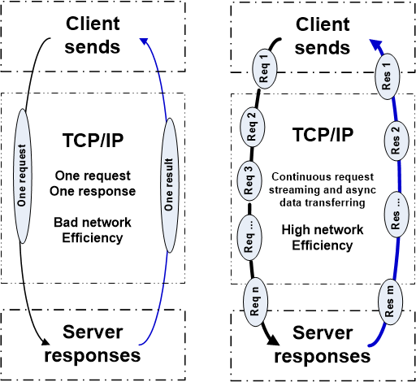
Two Basic Communication Patterns

Slide 3
Advantages and Disadvantages
SCF (Synchronous Communication Frameworks) | ACF (Asynchronous Communication Frameworks)
Good for typical applications Easy to get started Many free SCFs available Good for Local Area Networks (LAN) Simple in coding logic and better code readability Easy in debugging | Great for high-quality applications Great for challenging tasks Multiple communication models integrated Great for both LAN and WAN Great performance, UI response and scalability because of streaming & batching Great for both fat and thin clients Less threading-related problems Better user-code consistence
Bad for high-quality applications Bad for challenging tasks One communication model only Bad for Wide Area Networks (WAN) Bad performance, latency and UI response No dev/design freedom Many threading-related problems Bad scalability | Fewer high quality ACFs available Slightly more complex in coding logic and readability Slightly more difficult in debugging Difficult to create an ACF

Slide 4
SocketPro Communication Architecture and Components
Client Core
cross-platform
native code
Server Core
cross-platform
native code
Request batching and streaming, asynchrony, secure, parallel communication on TCP/IP
C++
Adapter
.Net
Adapter
Java
Adapter
Python
Adapter
JavaScript
Adapter
PHP
Adapter
Node.js
Adapter
C++
Adapter
.Net
Adapter
Python
Adapter
Java
Adapter
User Client Code
User Server Code

Slide 5
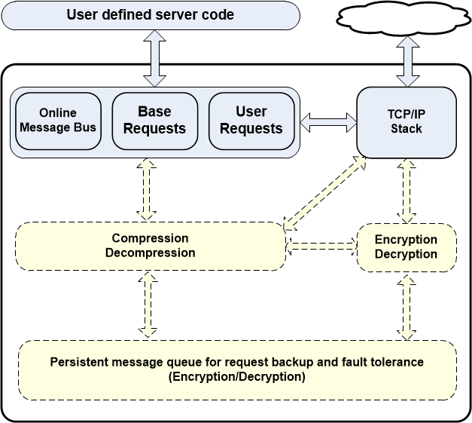
Client Core Features

Slide 6
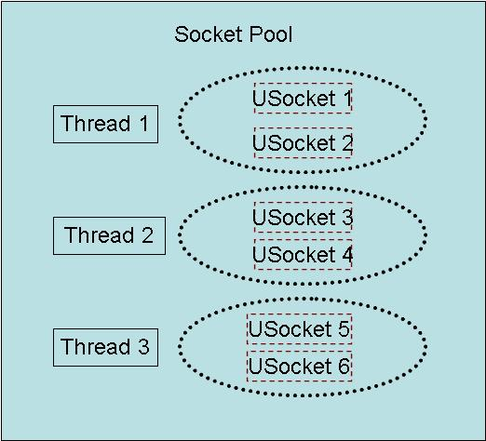
Client Socket Pool
A socket pool has three worker threads and each of these threads hosts two non-blocking sockets with fault tolerance for the best parallelism

Slide 7
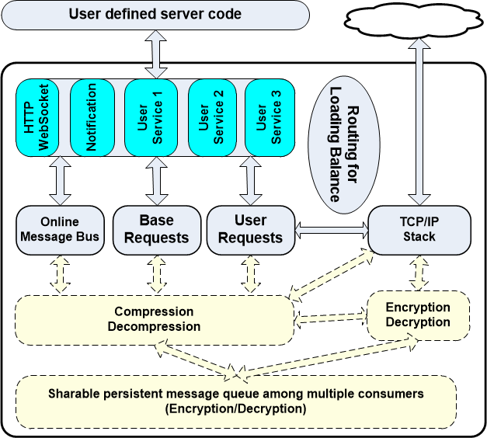
Server Core Features

Slide 8
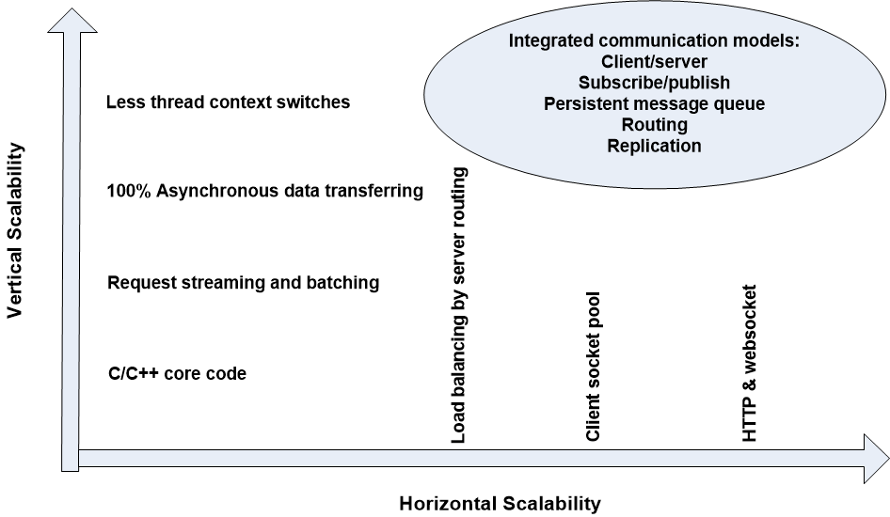
SocketPro Scalabilities

Slide 9
SocketPro Adapters for More Developers
C++ adapters – a few header and cpp files
One .NET adapter
Java adapter
Python adapter
Node.js adapter
One JavaScript adapter for browsers
PHP adapter in the future

Slide 10
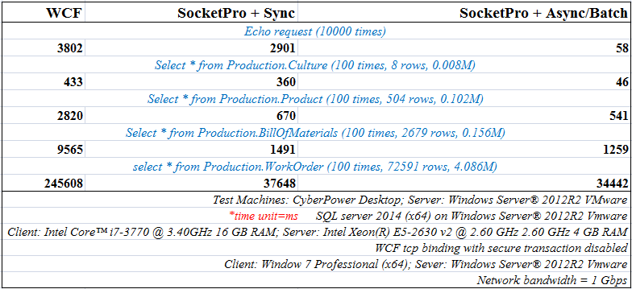
Client/Server Pattern

Slide 11
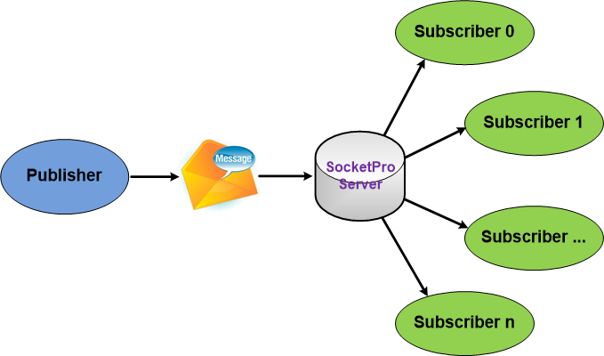
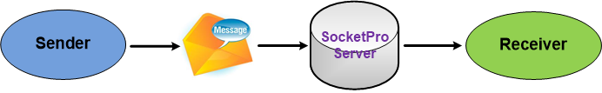
SocketPro Subscribe/Publish (Internet chat or online messaging)

Slide 12
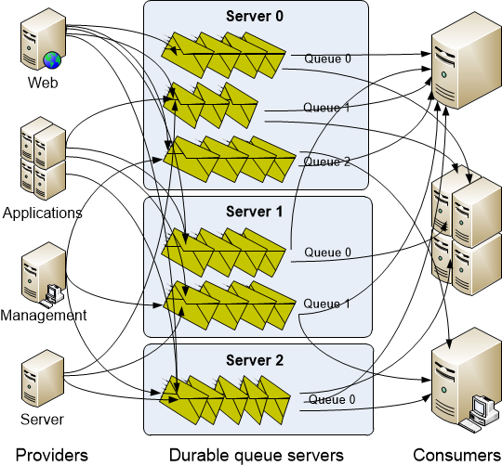
SocketPro Persistent Message Queue
Advantages of SocketPro over Kafka:
Manual transaction
Queue sharable among multiple consumers
Real-time message availability event (low latency)
No configuration settings
Faster than Kafka in message writing
Select a portion of requests to be queued persistently
No message loss as messages can be backed up at provider side

Slide 13
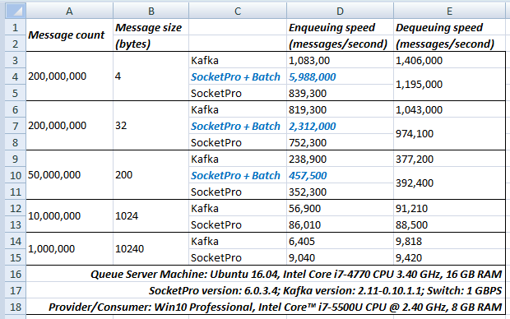
Performance Comparison between SocketPro Persistent Queue and Kafka

Slide 14
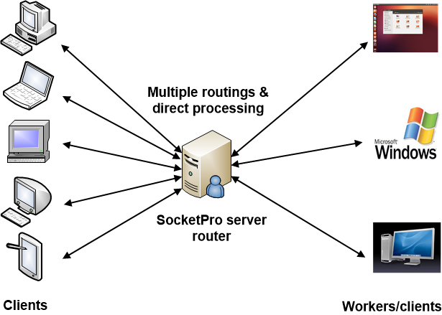
SocketPro Server Request Routing for Loading Balance with Fault Tolerance

Slide 15
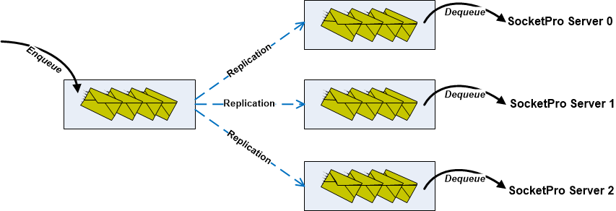
SocketPro Replication with ACID (Atomicity, Consistency, Isolation, Durability)

Slide 16
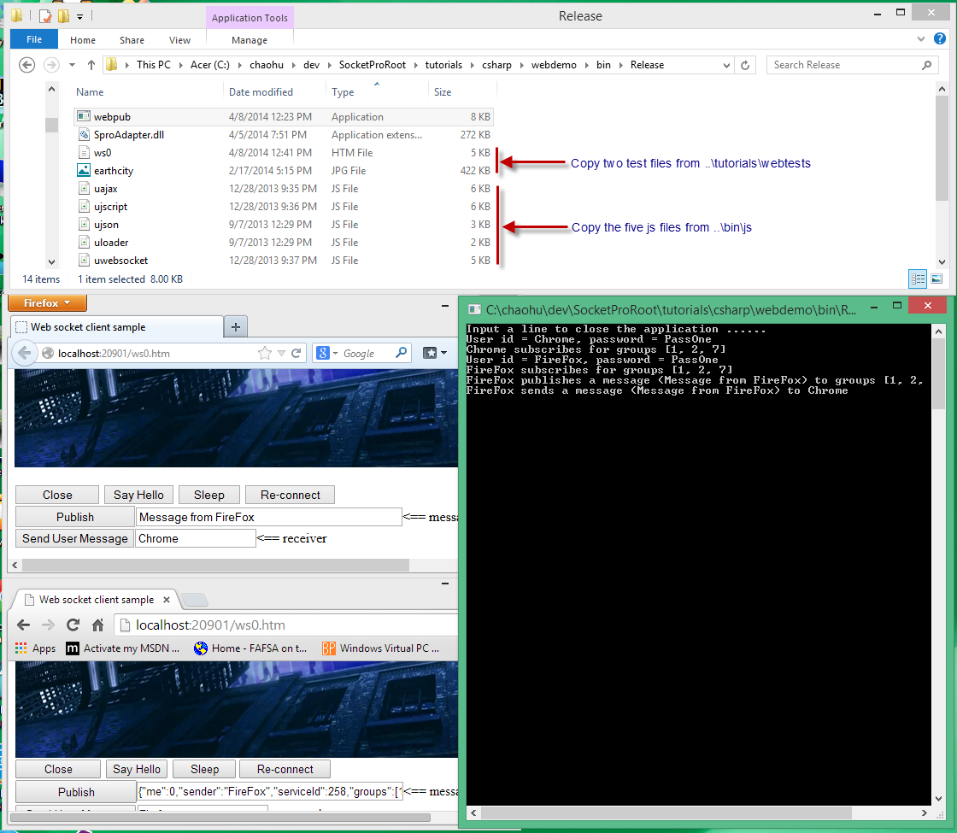
SocketPro HTTP/WebSocket

Slide 17
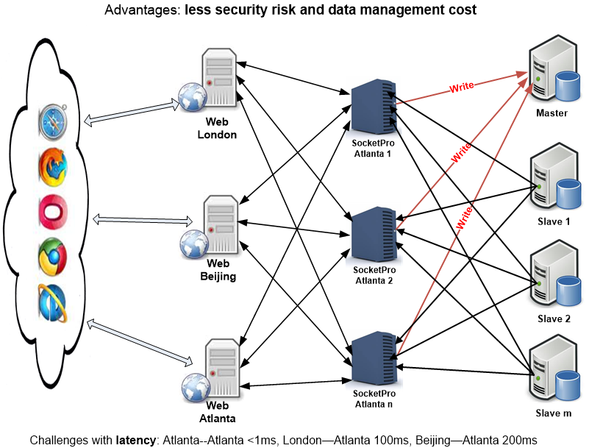
Global Web Systems by SocketPro

Slide 18
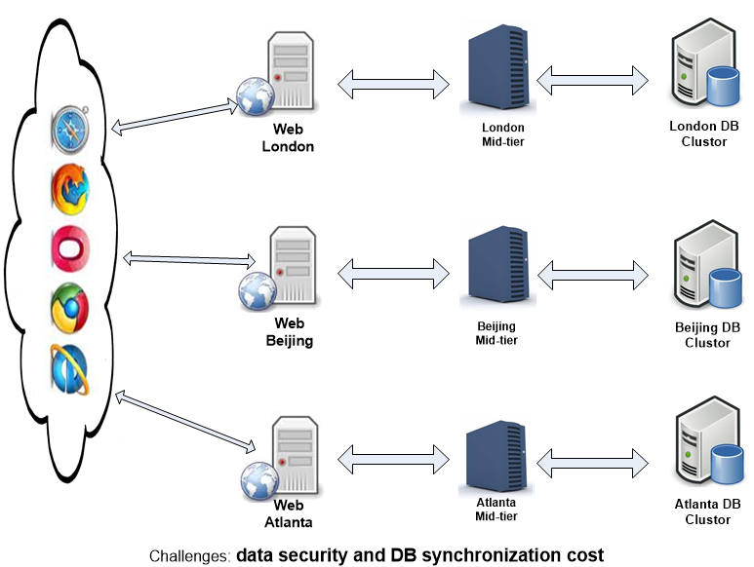
Global Web Systems by Common Approach

Slide 19
Generic Middle Tier and Client Components (Real-time Cache and SQL/Request Streaming)
Developing

Slide 20
Simplification of design and architecture
(Async/await, integrated computation modes, freedom, flexibility and rich features)
Great for tough tasks
(Great UI response, cache, lots of items, unstable/slow WAN, threading, and stability)
Great integration
Unified but simple interfaces for different dev languages and Oss
Excellent with performance and scalability
+ Great interoperation among different environments
Simple but fast development

Slide 21
Companies for SocketPro WAN Businesses
Hybrid cloud (WAN)
Globalization (WAN)
Centralized data center for better security and management (WAN)
Applications require decent stability, performance and scalability
Faster development
SocketPro is running great on WAN and high latency due to its streaming feature.
Less integration cost with SocketPro
There is fewer competitors for WAN businesses to SocketPro yet.

Slide 22
Major Challenges Funding/Human Resources
Business developments and marketing
Better documentations
More QA tests
Not available for IPhone, Android and MacOS
Many adapters (PHP and Node.js) not completed yet
Create services for customers
Generic client and middle tier with real-time cache
Remote file service

Slide 23
Major Web Sites
https://github.com/udaparts/socketpro
http://www.udaparts.com/
https://www.codeproject.com/Articles/1204807/Brief-introduction-of-a-continuous-SQL-stream-send
https://www.codeproject.com/Articles/1207129/Brief-introduction-of-a-continuous-SQL-stream-se

Slide 24
Questions ?

